Slide 1


EE307 Communication Systems
DEMONSTRATION OF
FREQUENCY
SHIFT KEYING
Presented By Group 8

Slide 2
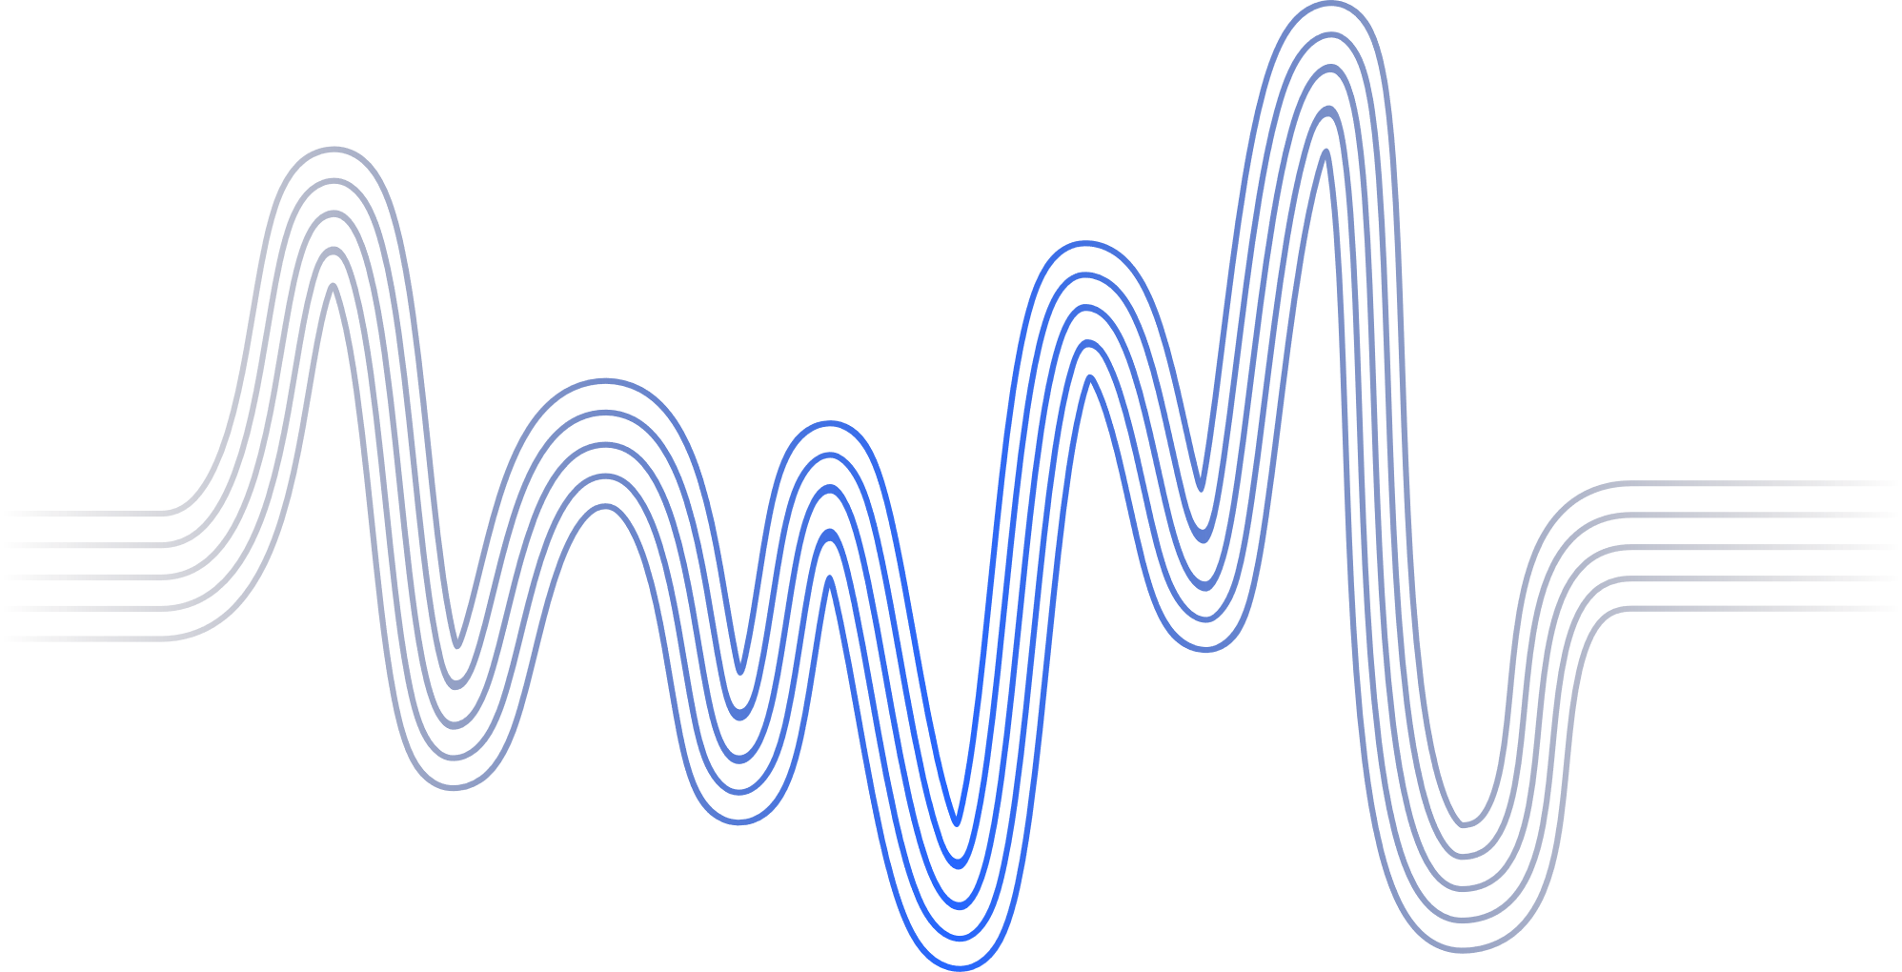
CONTENTS
General Introduction | 3
Project Overview | 4
Python Code | 6
Simulink Simulation | 8
Multisim Simulation | 12
Applications of FSK | 16
Relevance in Present Day | 18
Contribution Details | 19

Slide 3



GENERAL
INTRODUCTION
Frequency Shift Keying (FSK) is a modulation technique used in digital communication systems to transmit digital data over a carrier wave. In FSK, the binary data (0s and 1s) is represented by shifting the frequency of the carrier signal between two distinct frequencies. The carrier signal is typically a sinusoidal wave, and the shift in frequency corresponds to the binary data being transmitted.

Slide 4
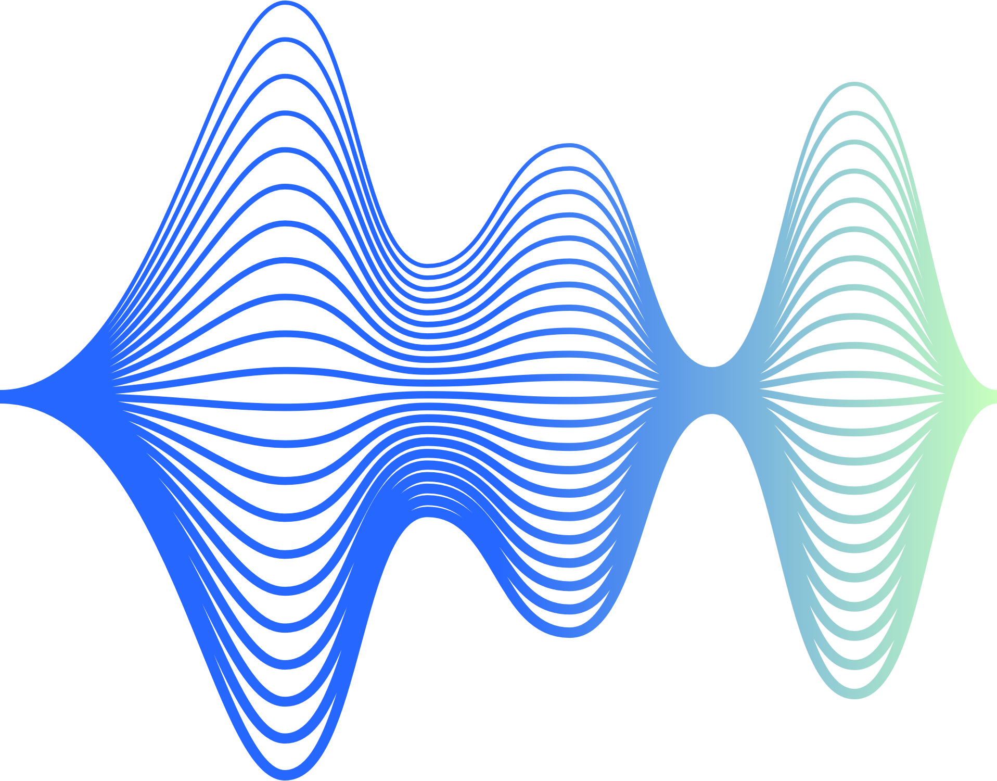
PROJECT OVERVIEW
Python Simulation:
Developed a robust Python program to simulate FSK modulation and demodulation.
Generated FSK signals by strategically shifting frequencies to represent binary data.
Implemented methods for demodulating received signals, establishing a fundamental software foundation for the project.
Simulink Analysis:
Constructed a comprehensive Simulink model to simulate an entire FSK communication system.
Integrated blocks for FSK signal generation, transmission through a simulated channel, and subsequent demodulation.
Facilitated in-depth analysis of FSK performance under controlled conditions, offering insights into its characteristics and behavior.

Slide 5
PROJECT OVERVIEW
(continued)
Multisim Circuit:
Translated theoretical concepts into practical application through a physical circuit in Multisim.
Engineered a circuit employing two transistors and various electronic components to achieve FSK modulation and demodulation.
Project Impact:
Executed a comprehensive exploration of FSK through a multi-faceted approach, combining software and hardware aspects.
Integrated Python, Simulink, and Multisim to provide a holistic understanding of FSK, bridging the gap between theoretical concepts and practical challenges.

Slide 6
PYTHON CODE
This code provides a comprehensive simulation of FSK modulation and demodulation, allowing for a clear understanding of the signal processing involved in digital communication systems.
Libraries such as NumPy is used for numerical calculations, array handling and Matplotlib for plotting graphs
The function, generate_fsk_signal,is used to generate a FSK modulated signal based on the provided parameters. NumPy is used to create time arrays (t), map binary message bits to corresponding frequencies, repeat the FSK signal to match the desired duration, and then modulate the signal using the sine function.
The demodulation function, fsk_demodulation it takes the modulated signal and extracts demodulated bits by analyzing the instantaneous phase and frequency of the signal. A threshold frequency determines whether a bit is '0' or '1'.
We have defined the parameters for the simulation, including the sampling frequency (fs), frequencies for '0' (f0) and '1' (f1), and the duration of the signal (duration).
A binary message is specified, and the FSK modulated signal is generated using the generate_fsk_signal function. The modulated signal is then demodulated using the fsk_demodulation function.
Four subplot figures shown in the next slide are created displaying the results for original message signal, FSK modulated signal, demodulated bits, and an overlay of the original and modulated signals.

Slide 7
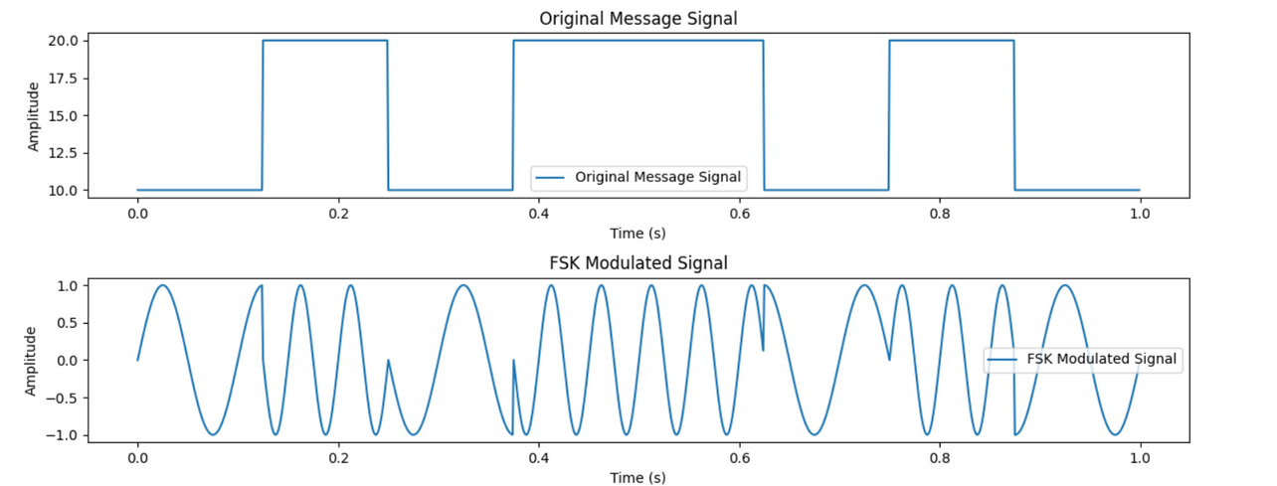
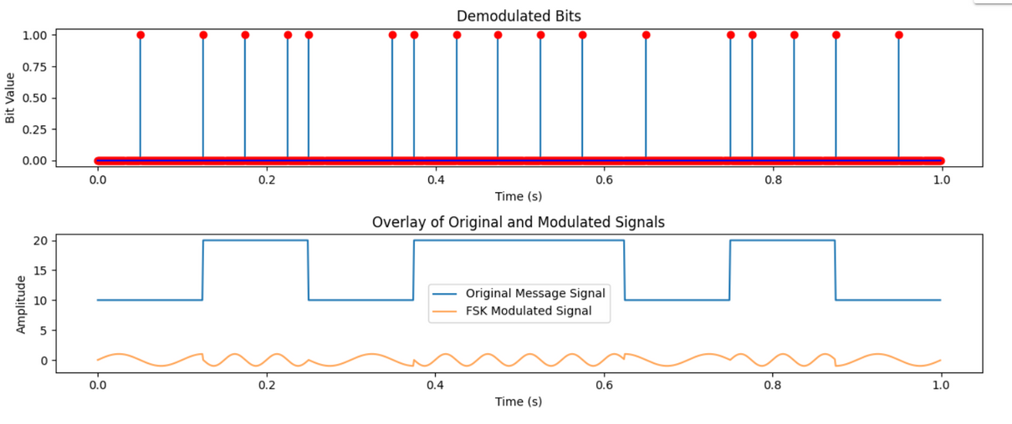
PYTHON CODE
FSK Modulation Plot
FSK Demodulation Plot

Slide 8
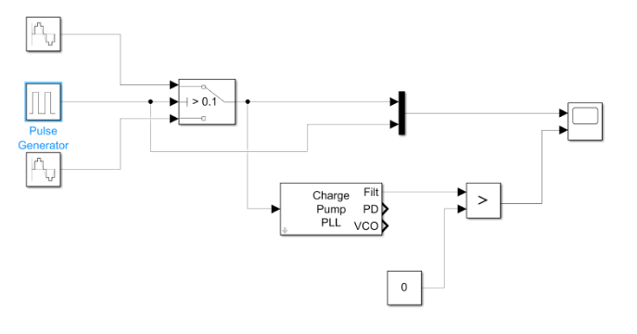
SIMULINK SIMULATION
FSK, a modulation method, alters a carrier signal's frequency to convey data. We conducted an experiment using Simulink to simulate FSK modulation and demodulation. Our aim was to grasp FSK's fundamentals and examine how modulation and demodulation impact signal transmission.

Slide 9
SIMULINK SIMULATION
(continued)
Modulation Circuit -
The modulation circuit is designed to implement Frequency Shift Keying (FSK) modulation. The Simulink schematic includes the following components:
Frequency input:
Generates a sine wave with a particular frequency. We used two of these with frequencies set to 12 Hz for high frequency input and 4 Hz for low frequency input.
Pulse wave generator:
Generates a rectangular pulse.
Ideal Switch:
An ideal switch that passes high frequency sine wave when pulse received from pulse wave generator is 1 and passes low frequency sine wave when pulse is 0.

Slide 10
SIMULINK SIMULATION
(continued)
Demodulation Circuit -
The demodulation circuit is designed to implement Frequency Shift Keying (FSK) demodulation. The Simulink schematic includes the following components:
Charge Pump PLL:
It automatically adjusts the phase of a locally generated signal to match the phase of an input signal. It acts as a Low Pass Filter.
Relation Operator:
Compares the output of the Charge Pump PLL to the constant value 0.

Slide 11
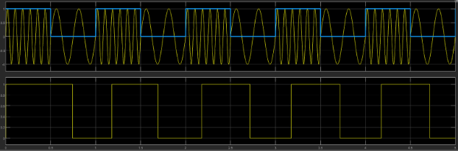
SIMULINK SIMULATION
(continued)
Observation -
We observed the following modulated and demodulated FSK waveforms. There is a phase shift induced in the demodulated waveform.

Slide 12
MULTISIM SIMULATION
The implementation of Frequency Shift Keying (FSK) modulation and demodulation using Multisim, unraveling the intricacies of signal transmission through the modulation and demodulation processes.
Major Circuit Components Needed
Voltage Pulse Generator
Voltage controlled Oscillator
Xor gates for switching
Opamp Comparators
Rectifiers
Voltage Divider

Slide 13
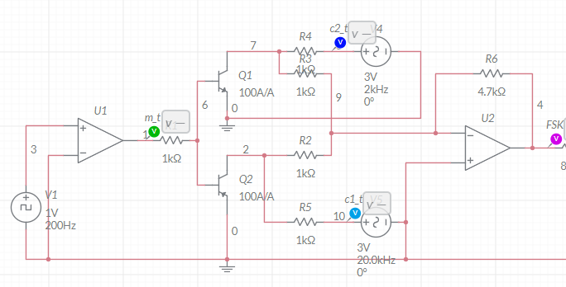
MULTISIM SIMULATION
(continued)
Modulating Circuit
Starting with a comparator to get pulse for modulation. Further there’s ciruitry for including the signals to be modulated and amplified.
This is the circuit signifying modulating circuit implemented on Multisim

Slide 14
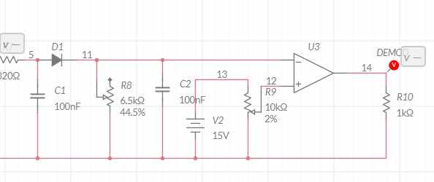
MULTISIM SIMULATION
(continued)
Demodulating Circuit
The output modulated wave is now fed to rectifiers further passed through peak detecting capacitive filters and then multiplied by the constant to have initial meassage wave.
This is the circuit signifying demodulating circuit implemented on Multisim

Slide 15
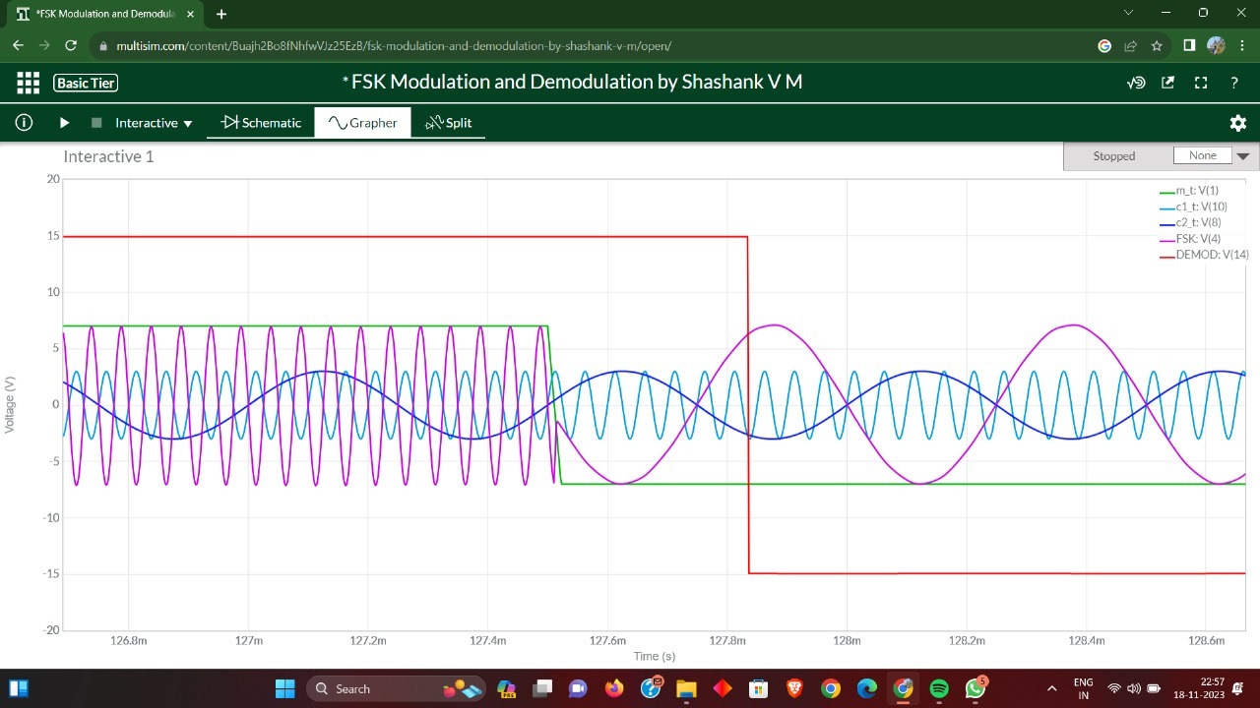
MULTISIM SIMULATION
(continued)
Results And WaveForm
Final Waveform of Modulated FSK, Demodulated FSK , initial square pulse waves.

Slide 16
APPLICATIONS OF FSK
Telecommunications Usage:
Prevalent technology for voice and data transmission in telecommunications.
Efficient in scenarios like cordless telephones and walkie-talkies, enabling wireless human speech transmission.
Data Transmission in Various Industries:
Integral to data transmission, especially in RFID systems for object identification and tracking.
Leveraged in satellite communication systems for global communication and broadcasting.
Role in Data Transmission Systems:
Employed in computer networks for reliable transmission over telephone lines and in wireless technologies like Bluetooth and Wi-Fi for seamless connectivity.

Slide 17
APPLICATIONS OF FSK
(continued)
Digital Broadcasting and Entertainment:
FSK modulation enhances digital broadcasting systems (DTV and digital radio).
Ensures transmission of high-quality audio and video signals for an enhanced entertainment experience.
Industrial Automation and Control:
Utilized in industrial automation and control systems.
Enables transmission of control signals and sensor data, facilitating remote monitoring and control in manufacturing and energy sectors.

Slide 18
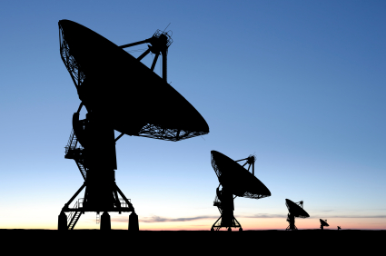
RELEVANCE IN PRESENT-DAY
Robustness: FSK is robust, especially in the presence of noise, but other techniques like QAM and OFDM can offer improved robustness.
Data Rate: Advanced techniques like QAM (Quadrature Amplitude Modulation) and OFDM (Orthogonal Frequency Division Multiplexing) generally support higher data rates compared to traditional FSK.
Bandwidth Efficiency: QPSK (Quadrature Phase Shift Keying), QAM and OFDM are more bandwidth-efficient than FSK, allowing for higher data transmission within the available spectrum.
In contrast to more advanced modulation schemes, FSK may not offer the same data rates or spectral efficiency. However, its relevance persists in specific use cases where its characteristics align with the communication requirements.

Slide 19
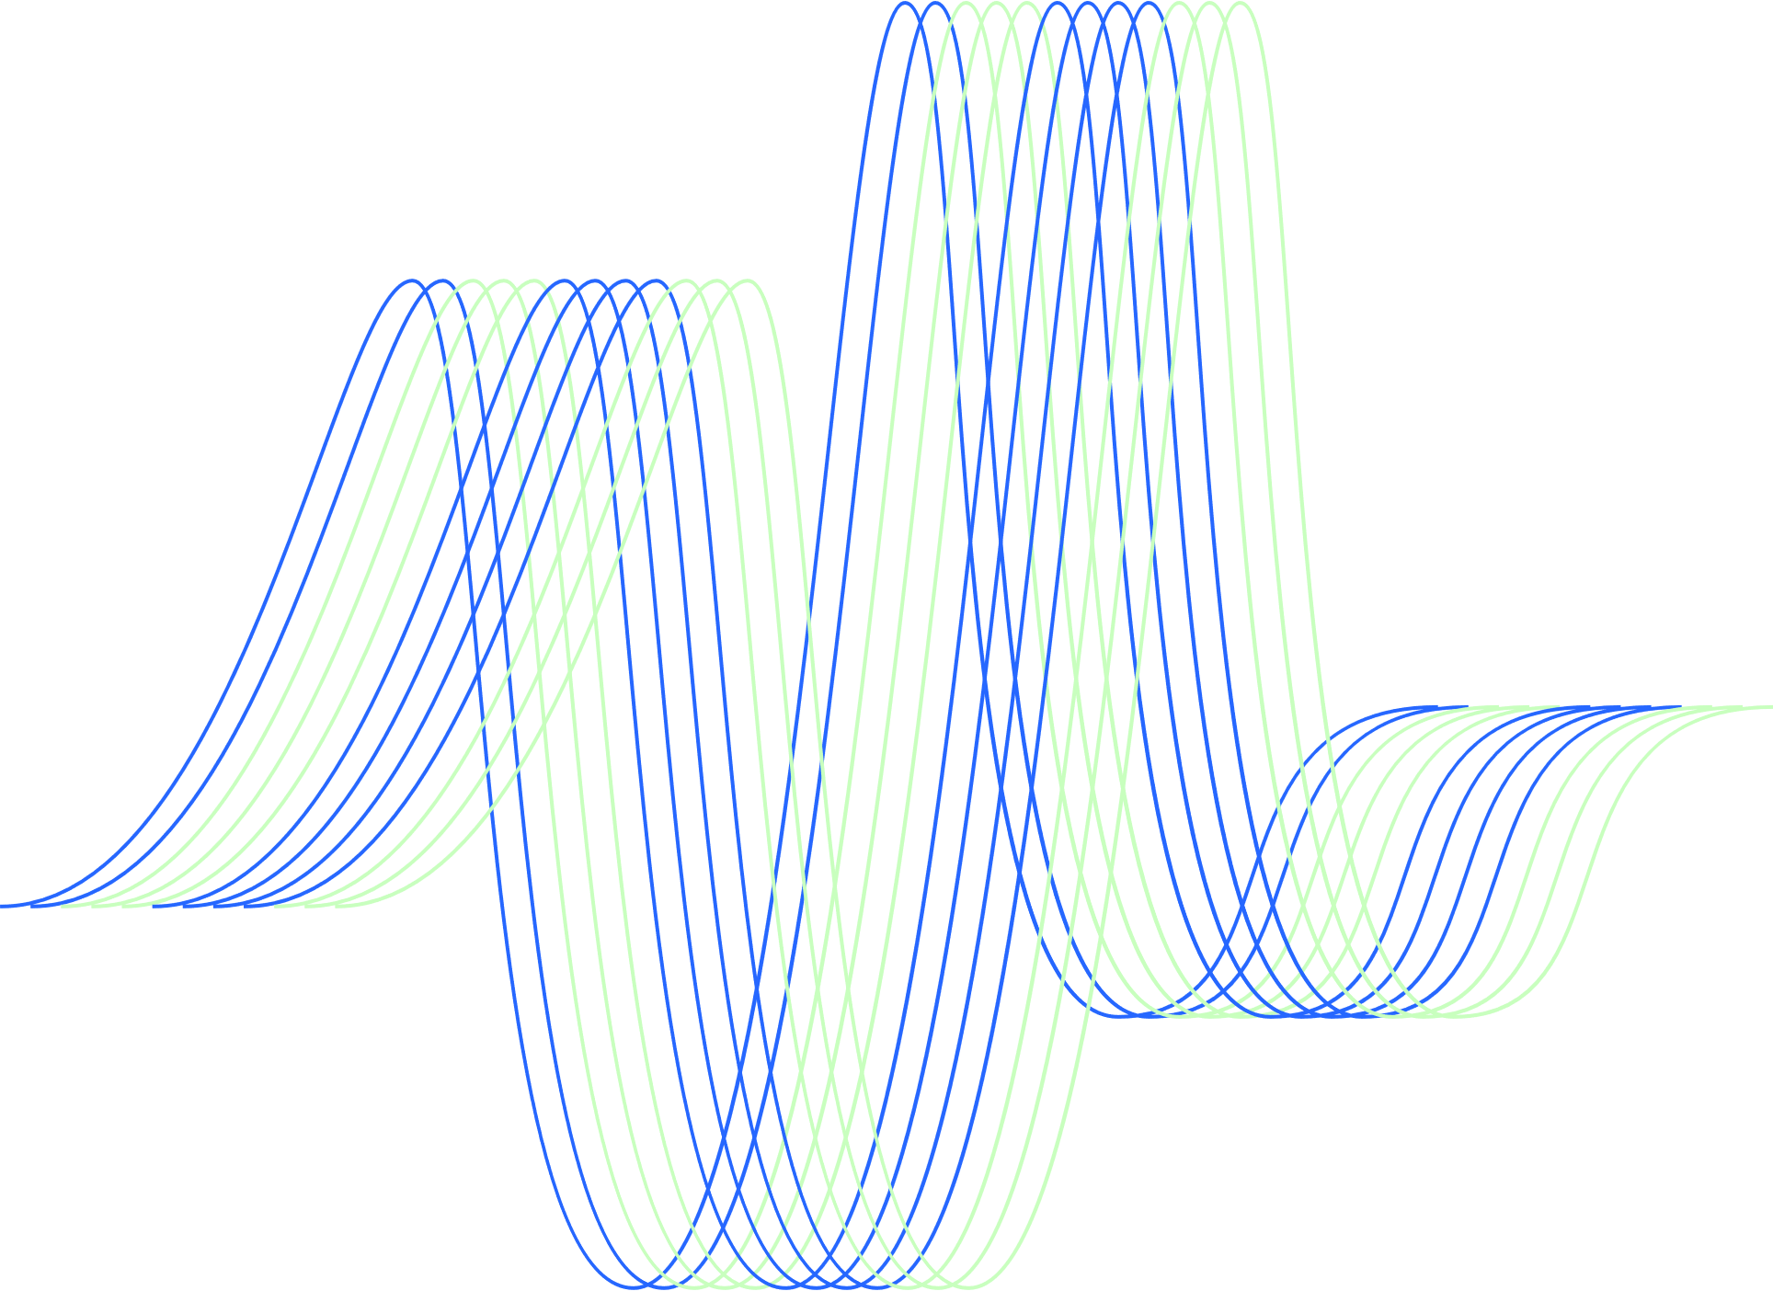
CONTRIBUTION DETAILS
Python Code, Report and Presentation by:
Ritika Dhaker, Rupal Shah, Shashank Sharma
MATLAB Simulink Simulation, Report and Presentation by:
Saattvik Thourwal, Sarthak Nandre
MultiSim Implementation, Report and Presentation by:
Ranu Lal, Rishabh Patil, Shaikh Baba
Report Layout and Template by:
Rupal Shah
Presentation Layout and Template by:
Ritika Dhaker

Slide 20
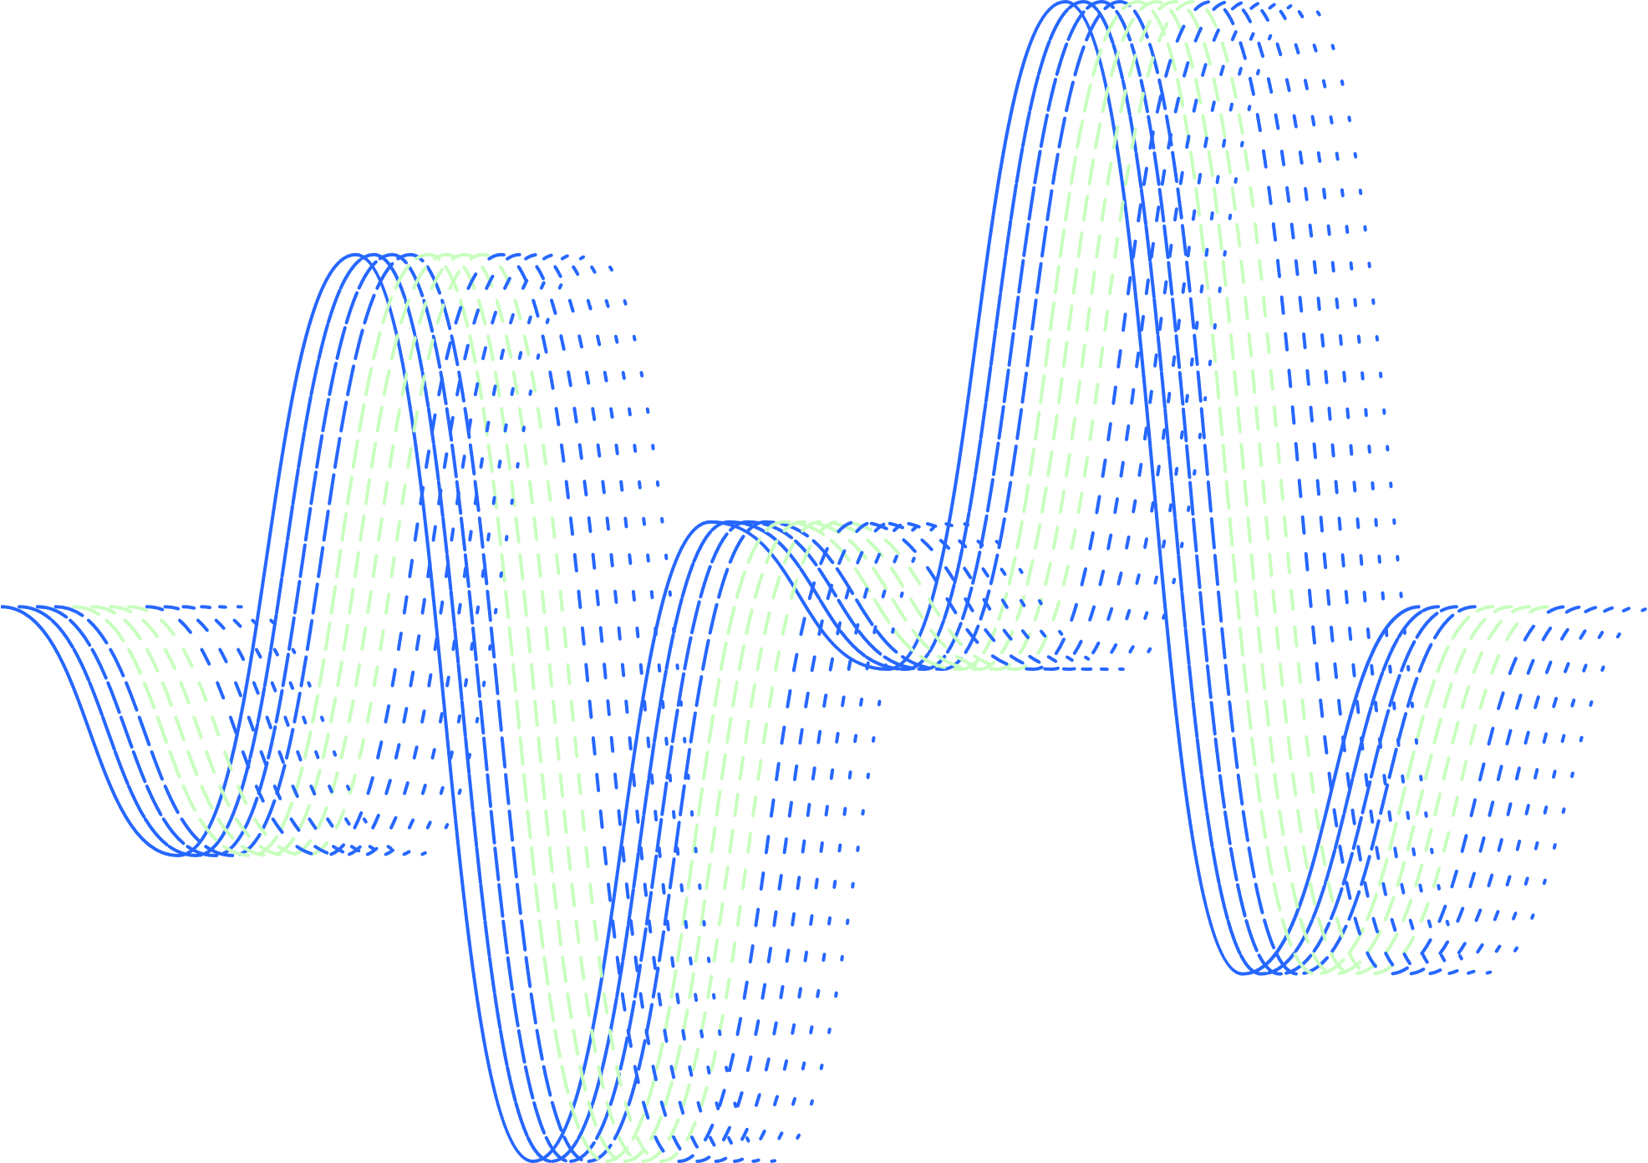
THANK YOU

